Slide 1


INTRODUCTION TO GITHUB
Mandy Farrugia

Slide 2
What is GitHub?
GitHub (software development repository) is an online cloud, just like OneDrive, Google Drive and Dropbox, in which files (each file no larger than 100MB/megabytes), projects and source code can be stored. It is used by a plethora of software development companies. Aside from having another backup, the advantage of using GitHub is that there are different versions of different saves one would have committed whilst working on their project. Should the project get corrupted, or a recent update mixes up the components, one can revert to previous versions, as well as download said version via GitHub. The code will be accessible to the user at any time. In the case of private repositories, the above applies to authorized users, also known as collaborators. Furthermore, GitHub is the ideal tool to collaborate with other team members, software developers and design teams, among others.
56 million users were reported to have registered with GitHub as of September 2020. GitHub was launched on 10 April 2008.

Slide 3
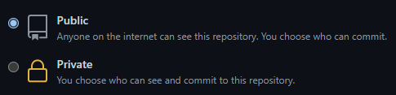
What is a repository?
A repository is a location in which files and projects are saved, think of it as a folder. In GitHub, multiple repositories are allowed. Moreover, multiple projects can be grouped into a single repository!
A repository will be created online so it can be synchronized with files. There will be a specific folder in the local drive/file system/storage medium which will be linked to the online repository via GitHub Desktop. Any changes in the local folder can be synchronized and found online.
The default accessibility is Public. One can modify accessibility settings at any time. In the case of private repositories, ONLY the user and other authorised users (collaborators) can access and commit changes.

Slide 4


What is GitHub Desktop?
GitHub (desktop counterpart for GitHub cloud) is an interface between GitHub cloud and the file system in which the local folder containing the repository is saved. GitHub cloud and GitHub Desktop go in sync together.
In short, GitHub Desktop is used to synchronize any locally available files within the repository with the online cloud. For the commit to be published on the online repository, for the first time you need to click on the Publish button and for the rest of the commits, you would need to press the Push button.
Push changes from local to GitHub cloud via GitHub Desktop.
Clone online repository to GitHub Desktop and store it locally on your computer.

Slide 5
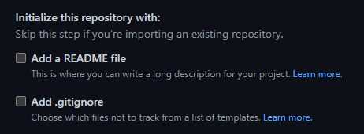
What is .gitignore?
.gitignore, as the terminology suggests, ignores temporarily files related to a particular software. Different software, amidst working on the project, will start creating temporary files which are then placed inside the project. Said files will not make any difference as to whether or not the project/application will behave/run. As they are extra files for the project to work with, they will take up extra space. Moreover, as a lot of temporary files are generated, it will take longer to commit changes to the folder. By ignoring temporary files, commits will be much faster.
Usually, the initial commit is a result of the .gitignore having been placed inside the repository (if the Add .gitnore option is enabled whilst creating the repository).

Slide 6
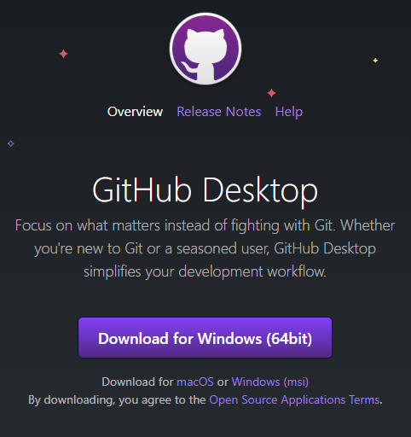
Downloading GitHub Desktop
Please download GitHub Desktop. The web application will suggest which version to download depending on your operating system and its architecture. If you have a 64-bit operating system, the website will recommend you download the Windows 64-bit counterpart. The Windows .msi counterpart will be recommended in the case of a 32-bit Windows operating system. If your computer is running macOS, then the macOS counterpart will be recommended.
At the time of writing, v.2.6.6 (released on Wednesday, 10th March 2021) is the latest version of GitHub Desktop.

Slide 7





Compatible operating systems
Kindly note that there is no binary (downloadable) version for Linux distros. There are open-source counterparts for said operating systems but this is beyond the scope of this course.

Slide 8
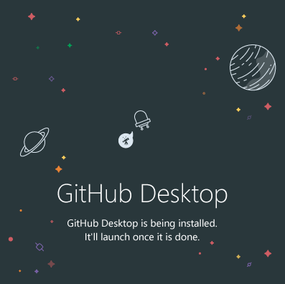
Installing GitHub Desktop
Kindly wait for GitHub Desktop to finish installing. This might take a while depending on your computer specifications. Please do not interrupt the installation process.
Feel free to enjoy a cup of coffee, go on a walk or take a nap. You will subsequently be asked to enter your authentication details after the installation is completed.

Slide 9

New to GitHub? Click on Sign up!
You can alternatively sign up by entering a valid email in the text box as pictured above, then pressing Sign up for GitHub.

Slide 10
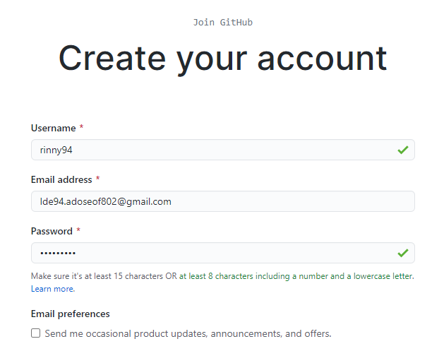
Signing up for GitHub
You will be asked to solve a puzzle to verify your account. Once you have successfully verified your account, press Create account.

Slide 11
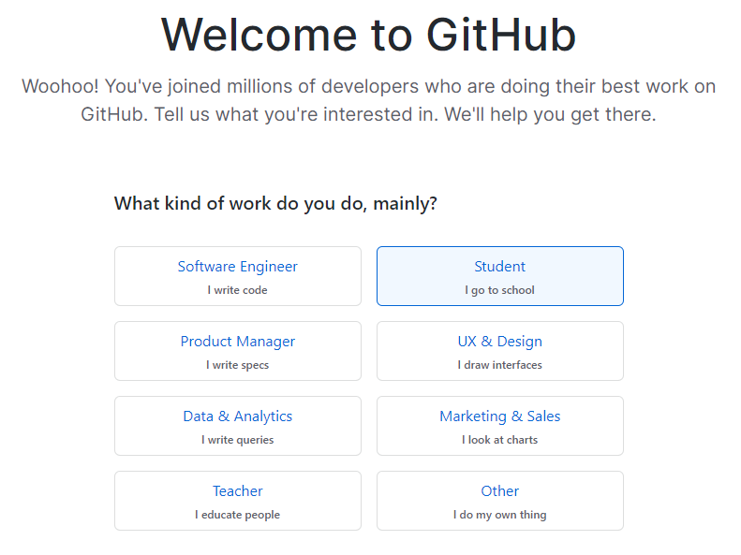
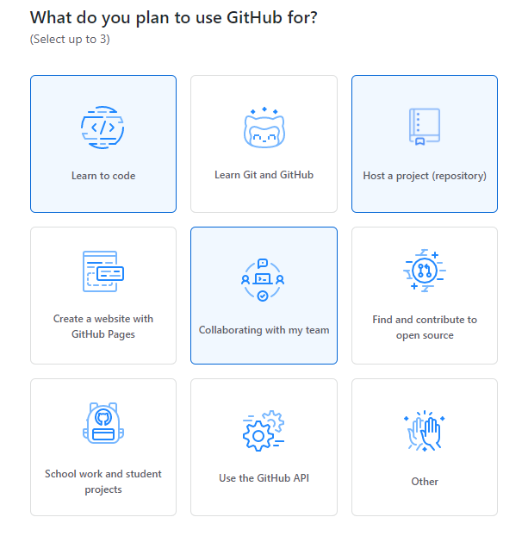
See for yourself whichever options you deem best…

Slide 12
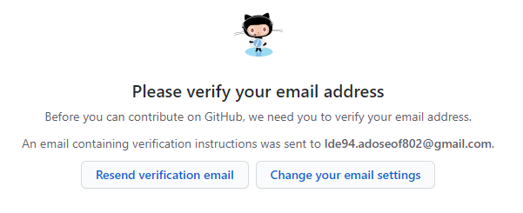
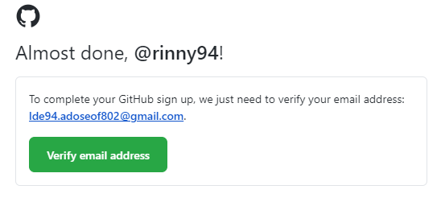
Verifying your email address
Kindly access your inbox and check whether you have received an email prompting you to verify your email address. I would highly recommend checking Spam/Junk folders, as well as Unfocused in the case of Outlook. Once you have received the verification email, press Verify email address. Then you will be good to go.

Slide 13
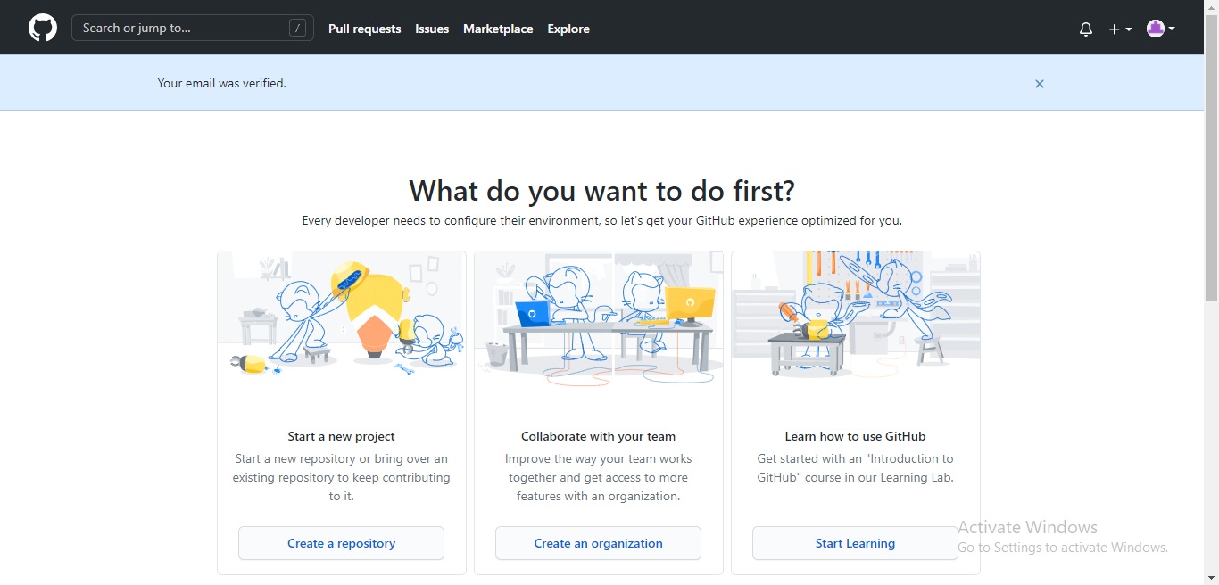
Congrats! You are now verified!

Slide 14
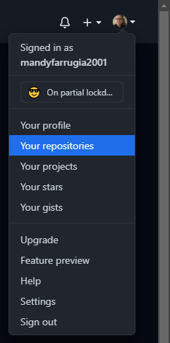
How to access your repositories…
On the far right side of the navigation menu, you will see your avatar next to the notifications and add repository buttons. Select Your repositories. You will then be taken to a webpage displaying all available repositories, regardless of their accessibility.
The anatomy of the link showing all available repositories goes as follows:
https://github.com/[username]?tab=repositories
Do not include the square brackets.

Slide 15
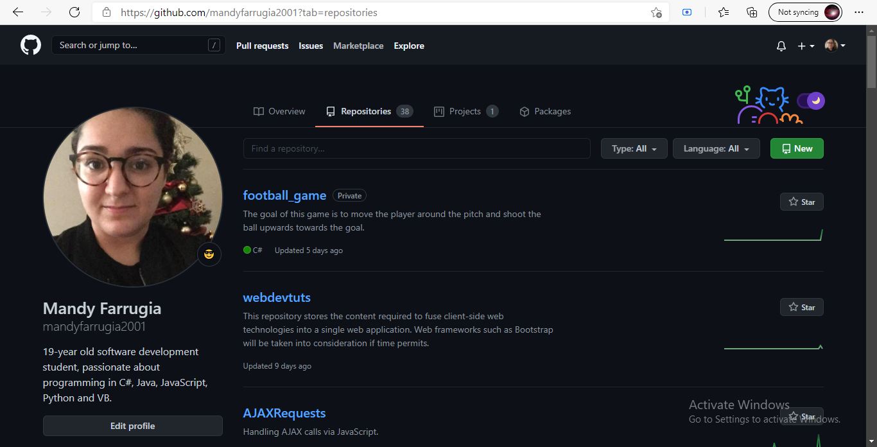
A list of private and public repositories…

Slide 16

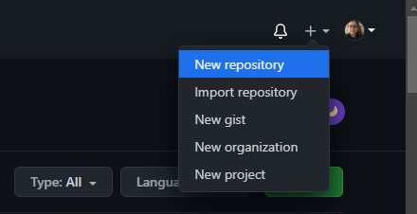
How to create a repository
You may either press the New button within the Repositories page or you may press the + button and select New repository. Either method yields the same result.

Slide 17
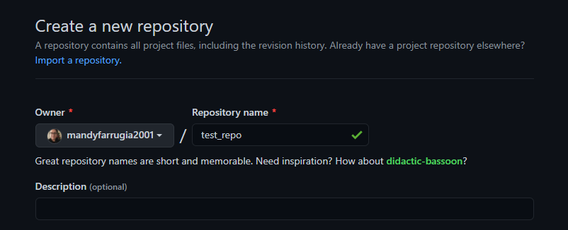
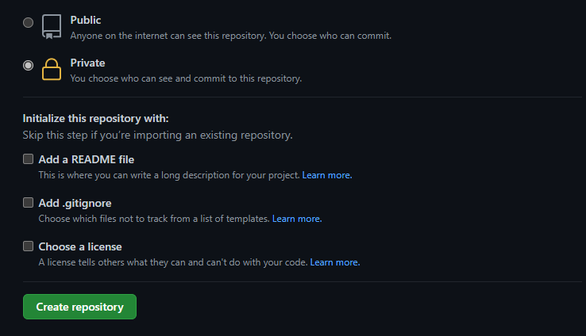
Creating the repository
Creating the repository consists of the following steps:
Naming the repository, as well as adding a description if need be. For a test repository, there is no need to add a description. This would only be ideal in the case of a team-work based project where the members would need to know what is the aim of this repository and what it stores.
Selecting the accessibility.
Given we will not be dealing with temporary files (as opposed to when it comes with Unity/Visual Studio), there is no need to add .gitignore. Adding a README file is also not necessary either.
Click Create repository and tada, your repository will be up and running soon enough!

Slide 18
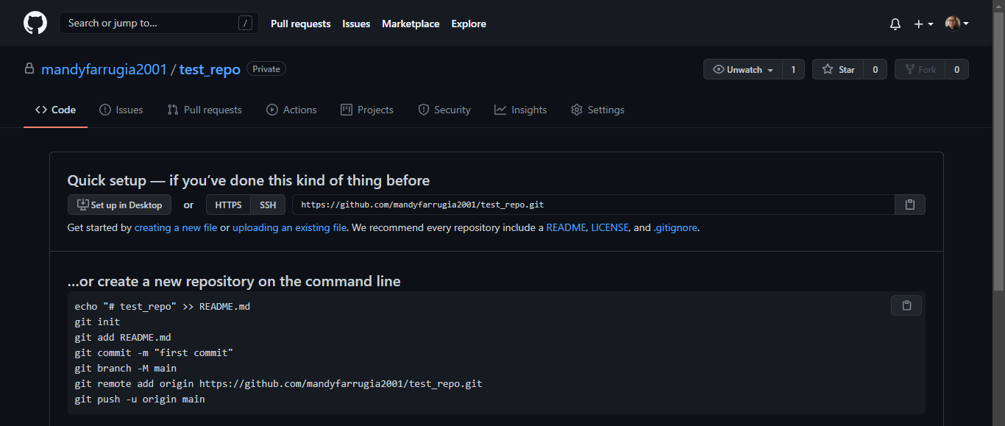
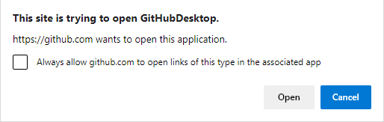
Allow GitHub cloud to open GitHub Desktop to clone the repository
Select Set up in Desktop. If you already have GitHub Desktop installed, an alert box should show up prompting you to accept or deny the request to open GitHub Desktop. Enable Always allow github.com to open links of this type in the associated app, then select Open.

Slide 19
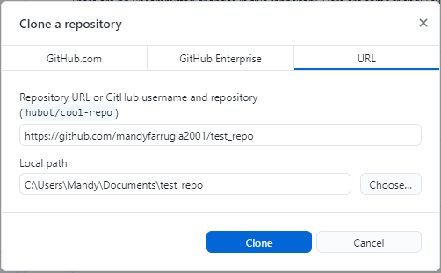
Cloning the repository
You may choose to clone the repository anywhere you want in the file system as long as it is accessible. Please do not modify the content inside the first text field containing the repository URL.

Slide 20



Adding collaborators to a private repository in GitHub Cloud
As a repository owner (there can be only ONE owner of a repository), you possess full control of your repository. In the case of public repositories, anyone can access your repository (even netizens who are not registered with GitHub). However, when it comes to private repositories, only the repository owner can access and modify the repository. In GitHub terminology, authorized users who can access a private repository are known as collaborators.

Slide 21

What can a collaborator do?
Clone the repository via GitHub to their file system.
Upload files via cloud-based GitHub counterpart.
Add README file to the repository.
Fork a copy of the repository into your account.

Slide 22

What cannot a collaborator do?
Delete the repository.
Modify the accessibility of the repository.
Invite other collaborators.
Archive the repository (rendering it read-only).

Slide 23
Forking a repository
Forking a repository refers to copying someone else’s repository into your own account. The forked repository inherits all the features from the parent repository.
You would be able to:
Delete the repository from your end, but not from the owner’s end.
Archive the repository, thus rendering it read-only. (Uploads would not be allowed in such a case)
Commit to the repository.
However, you would not be able to:
Transfer the repository. You would need to contact the owner of the repository.
Change the visibility of the repository. In order to do so, you would need to duplicate the repository.
It is important to note that any changes within the forked repository will NOT affect the original repository.

Slide 24
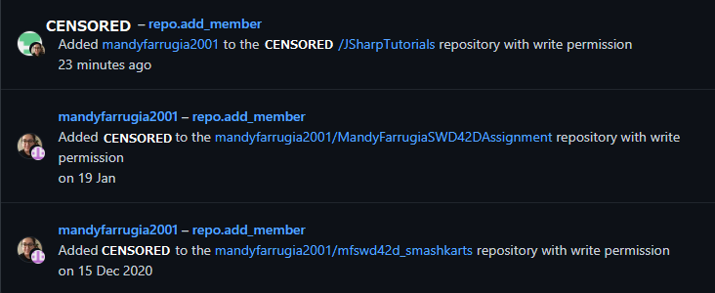
Instances of collaboration on GitHub
Kindly note that usernames have been censored with respect to Data Protection Act,
taking into account that sessions will be recorded and the repository is public.

Slide 25
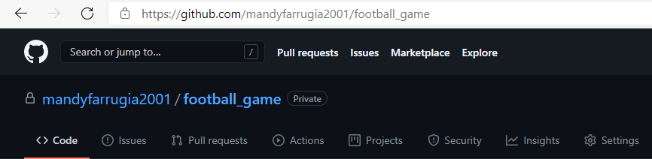
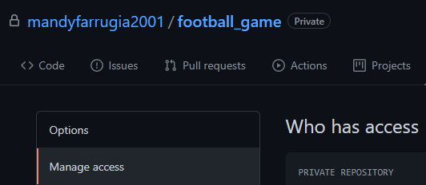
How to add collaborators to your repository via GitHub cloud…
Access the desired repository.
The anatomy of a GitHub repository goes as follows:
https://github.com/[username]/[repository]
Do not include the square brackets.
Select Settings from the navigation menu.
Navigate to Manage access from the sidebar menu.

Slide 26
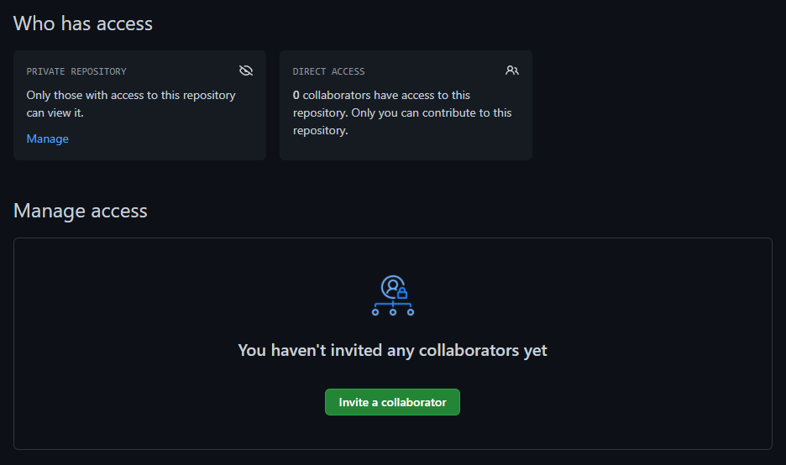
Click on Invite a collaborator.

Slide 27
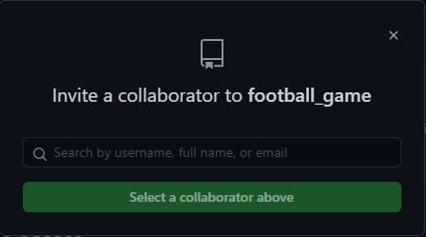
Inviting a collaborator to your repository
Ideally, you should ensure that the collaborator is already registered with GitHub. You may add a collaborator via email address or username.
Below please find my details should you ever need to add me as a collaborator.
Username: mandyfarrugia2001
Email: mandy.farrugia.c10352@mcast.edu.mt

Slide 28
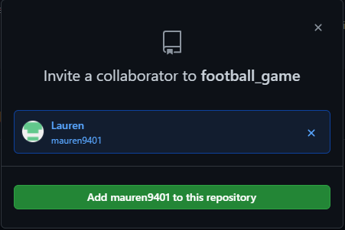
Final step to inviting collaborators to your online repository
You may only invite one collaborator at a time. If you need to add more collaborators, simply press Add [username] to this repository and repeat the previous steps.
The collaborator will subsequently receive an email prompting them to accept or decline the invitation. Said invitation is valid for a week.

Slide 29
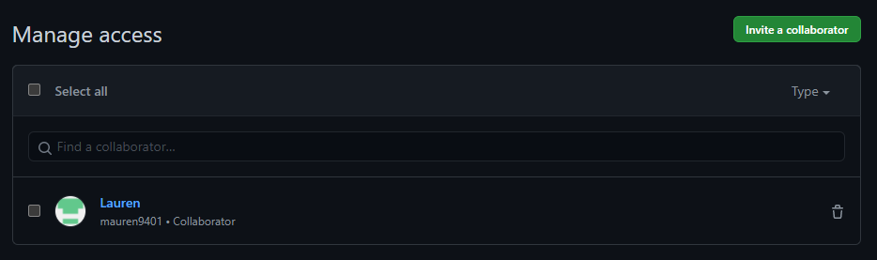
And voila! The collaborator has accepted our invite!

Slide 30
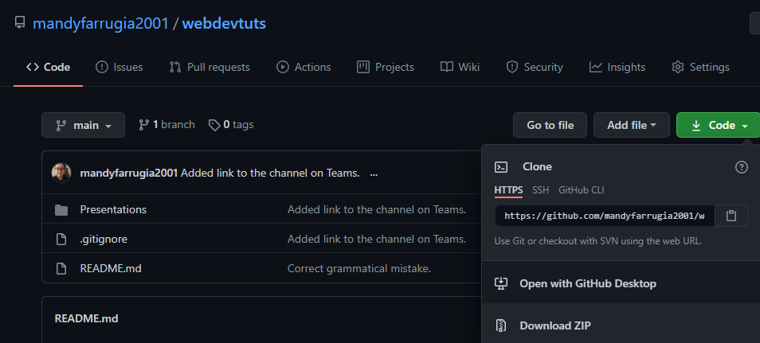
Linking online repository with file system
Go to the repository which you want to clone. Press the Code button and select Open with GitHub Desktop. If you don’t have GitHub Desktop installed, kindly install it via https://desktop.github.com/.

Slide 31
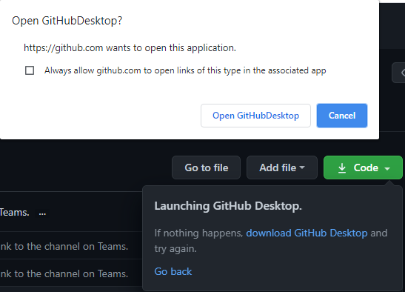
Press Open GitHub Desktop…

Slide 32
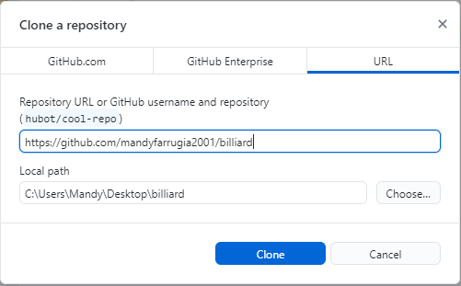
Cloning online repository into file system
The local path refers to the path in which you want to clone your repository.

Slide 33
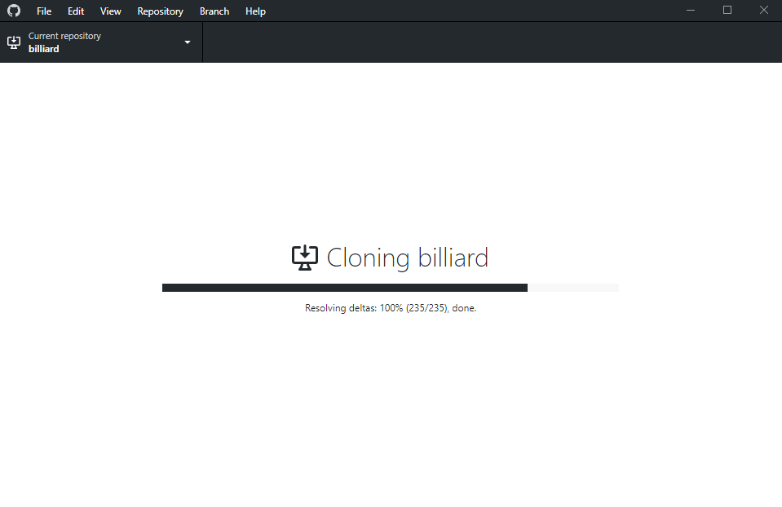
Give it some time to clone the repository…
If the repository is empty (given you can upload to your repository via the web-based GitHub but why should we when there is GitHub Desktop?), it should not take that long to clone the repository. It usually depends on the network and computer specifications.
Meanwhile, sit back and enjoy a glass of orange juice/cup of coffee. ☺

Slide 34
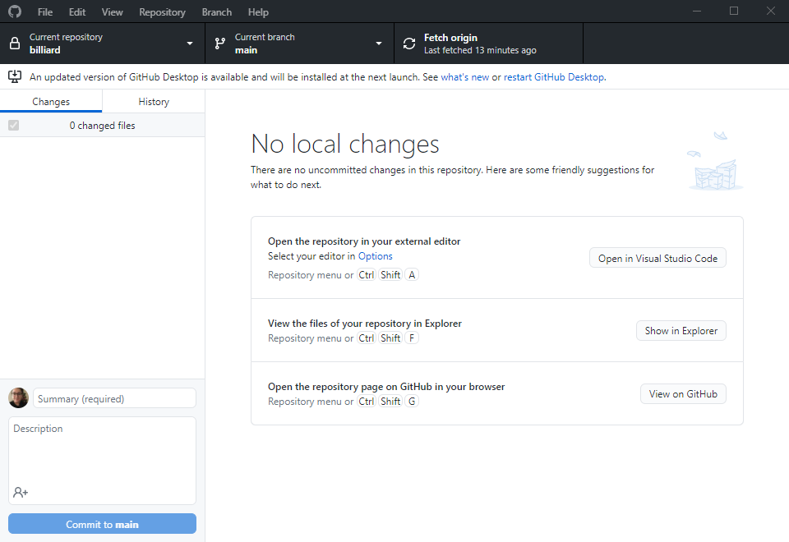
Behold, GitHub Desktop!
If you have arrived at this stage, then you have successfully cloned your online repository to your file system. Any modified files will appear in the Changes tab. You also have the option to commit changes as per the Commit to main button.

Slide 35
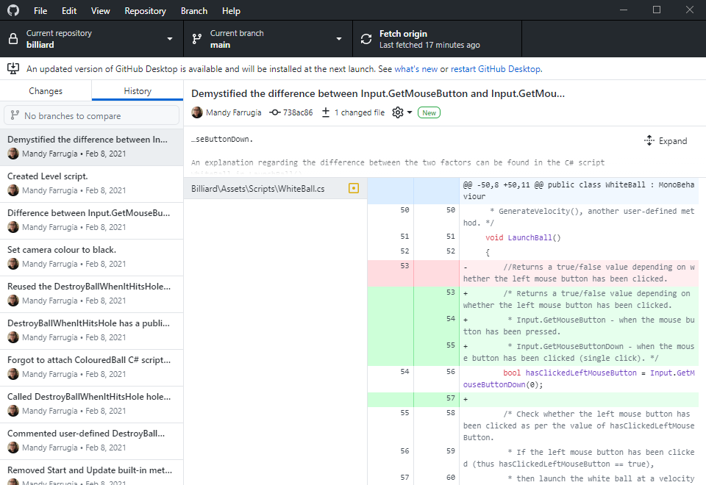
GitHub Desktop’s History feature
As discussed previously, one can view different save versions (otherwise known as commits in GitHub terminology). This can be very helpful when it comes to team-work based projects where each member can keep track of the progress of that another of team member. Moreover, one can also revert to a previous commit or delete a particular commit.

Slide 36
Committing to your repository
As explained previously, we have cloned the repository to our file system. Any changes inside the repository will be visible in the Changes tab in GitHub Desktop. We can then choose to ignore them or upload them, thus committing recent changes to our cloud-based repository.
For instance, if we add a text file to the repository, this folder will appear in the Changes to be uploaded to the online repository. In short, GitHub will keep track of any changes happening in the repository (such as adding files/directories, editing files and so on and so forth).
However, GitHub Desktop will not automatically upload changes from the locally-available repository to the cloud based counterpart. You will need to commit and then push the changes yourself in order to have the changes on GitHub cloud as well.

Slide 37
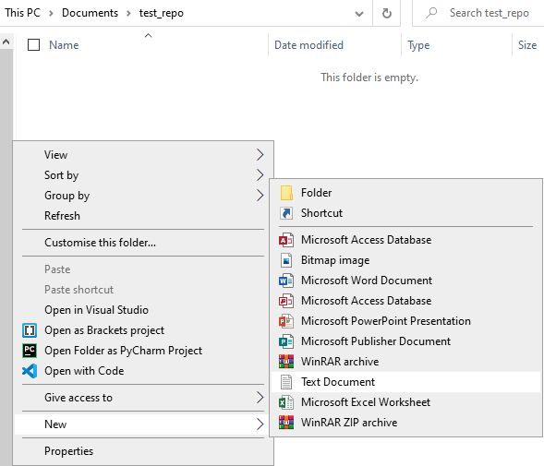
Let’s try adding a text file to our cloned repository!
Right click anywhere inside the folder and select New > Text Document (or folder, whatever you deem best). You will then be asked to give a name to the text file. We will then check GitHub Desktop to see whether or not it has detected any changes within the repository.

Slide 38
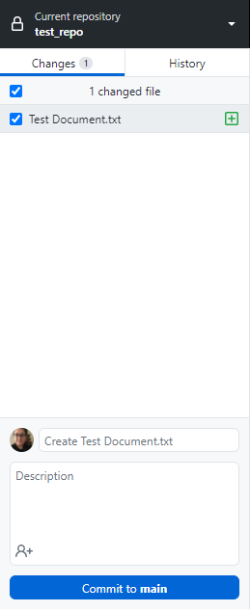
GitHub Desktop has detected changes!
We can see that GitHub Desktop has detected changes as a text file has been created inside the repository. Moreover, we can also see that a summary has also been generated.
Let’s what happens when we click Commit to main.

Slide 39
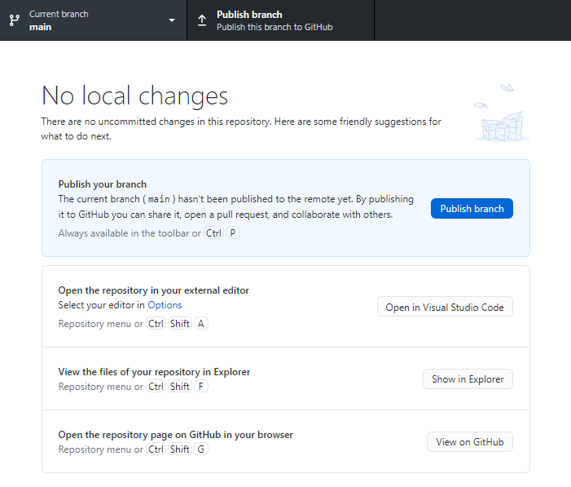


Publishing the repository to GitHub cloud
The commits were successful but first, we need to publish the repository to GitHub cloud. This will only be required once, then we will be asked to push in order to upload the changes from the file system to GitHub cloud. When we publish the repository, GitHub Desktop will then push the contents of the locally available repository to the online repository.

Slide 40
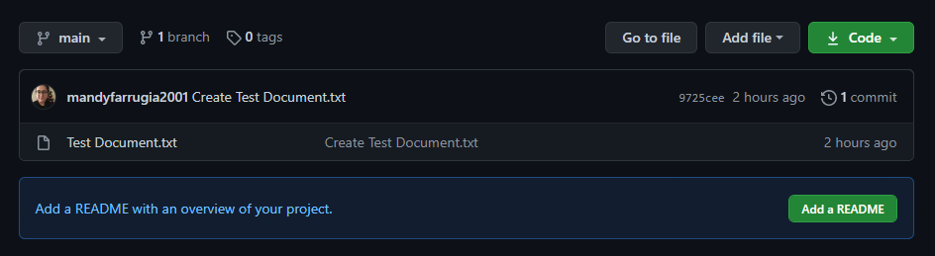
Evidence that changes have been inflicted on the online repository

Slide 41
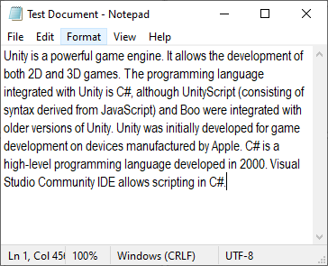
Let’s try modifying the text file!
Always remember to save the file, otherwise GitHub Desktop won’t be able to detect changes. This will also apply when we are working on .html, .css and .js files. If the filename is prefixed by an asterisk (*), then it means that the file has not yet been saved.
A general rule of thumb is that you save every once in a while when working with a software application without auto-save feature. GitHub Desktop aside, computers can be incredibly unpredictable and a sudden shutdown/restart or software crash can happen when you least expect it!

Slide 42
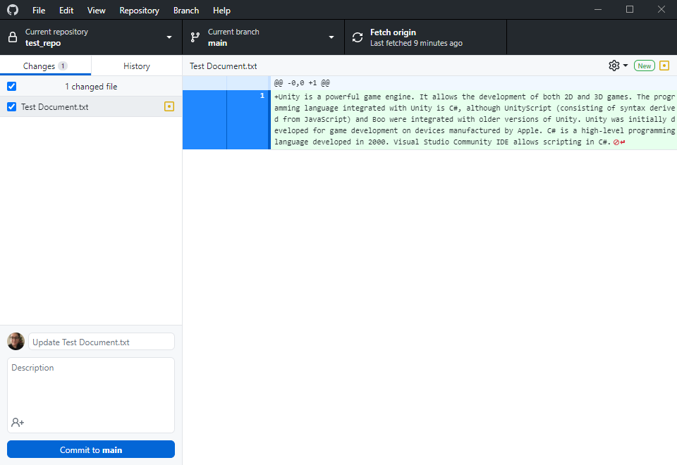
GitHub Desktop has detected that we have edited the text file.
As you can see, GitHub Desktop has noticed that the text file has been modified. The right hand side shows the changes in the text file, in this case, we have added text to the initially empty text file. You may notice that the summary has been generated once again.
You may commit again.

Slide 43
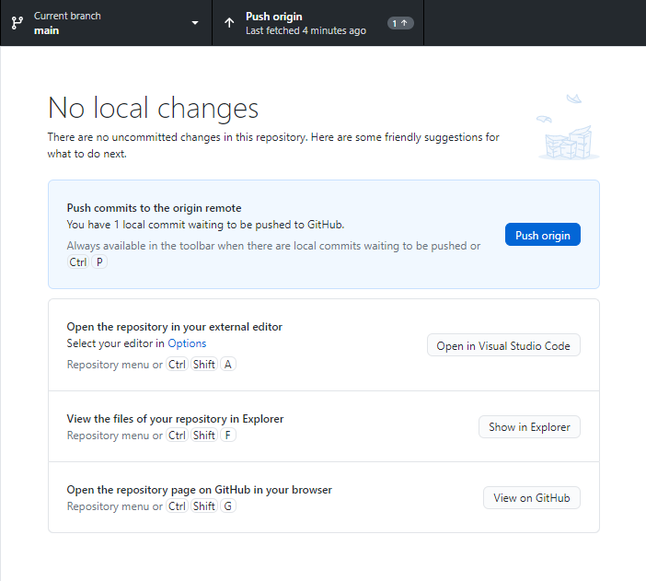
Pushing commits to GitHub cloud
You may push the recent save state to the online repository by pressing Push origin or by means of the key combination Ctrl + P. You will be required to push commits to GitHub after each successful commit, in order to have the changes visible in GitHub cloud as well.
Kindly note that an internet connection is not required for commits but is required to push commits to the online repository.
Moreover, no local changes means that GitHub Desktop has detected no deletions, additions or changes in general in the locally available repository.

Slide 44
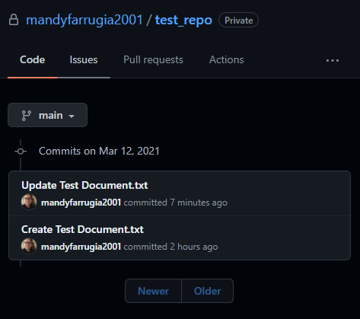
List of commits
As you can see, there is a list of commits pushed to GitHub cloud starting from the most recent commit. You may acquire further details about commits by pressing on the summary. It will give you an idea which files were modified and what happened in a specific save state.

Slide 45
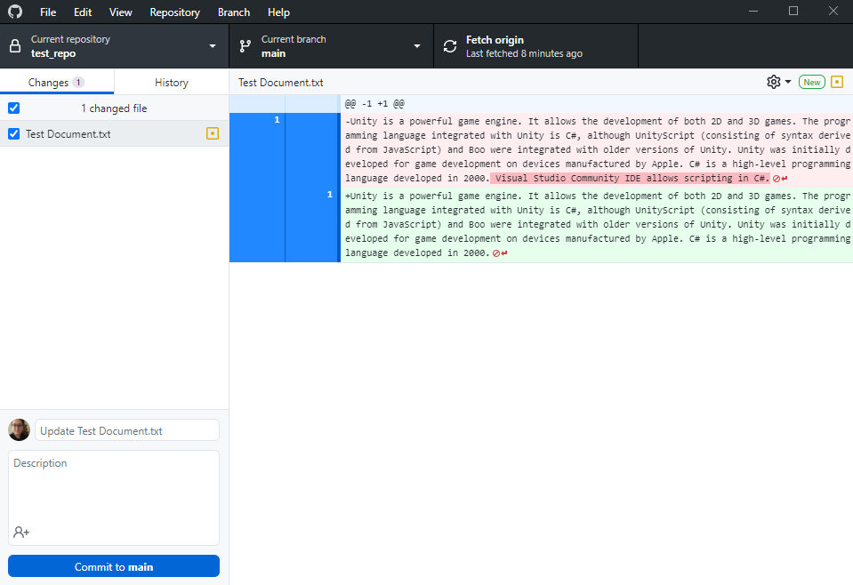
GitHub Desktop has also detected that we have removed the last sentence!

Slide 46
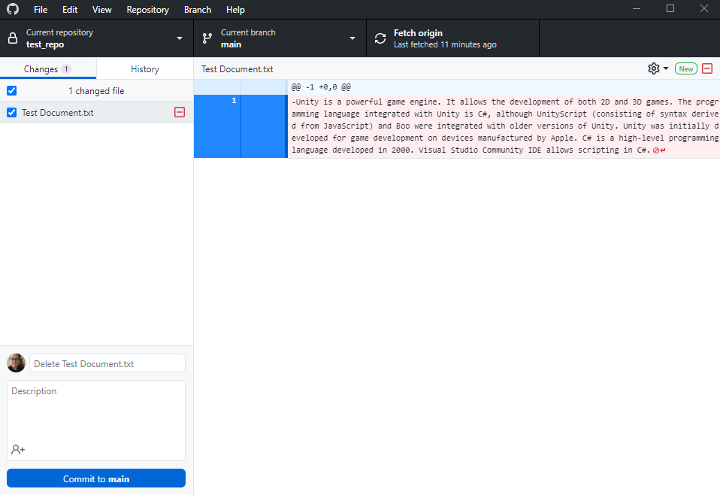
GitHub Desktop can also detect deletions in a repository!
GitHub Desktop has detected that we have deleted the text file. The summary has also been generated depending on the action taken.
You may optionally commit and push to GitHub.

Slide 47
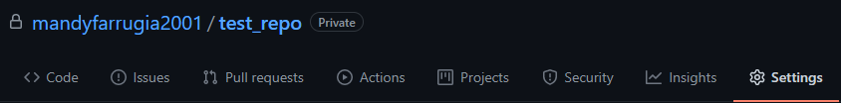
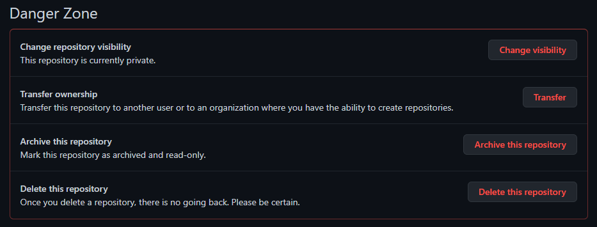
Changing repository accessibility
Let’s say you accidentally left an important repository with a visibility of public. Fear not, you can modify the accessibility via repository settings. Scroll down to Danger Zone section after navigating to Settings tab.

Slide 48
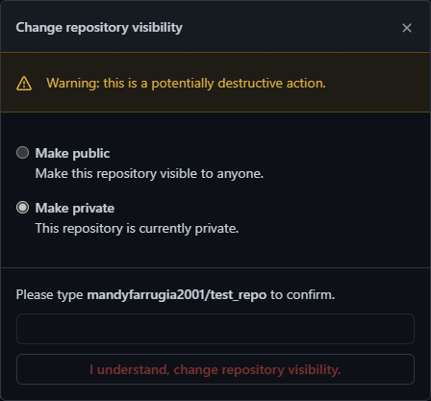
Changing repository accessibility
You will be asked to enter your username and the name of the repository, both of which are to be separated by a dash.
Select the accessibility according to the scenario. Once you have entered the username and name of repository correctly, press I understand, change repository visibility.
You may revert to the previous accessibility by repeating the steps from the previous slide and this one as well.

Slide 49
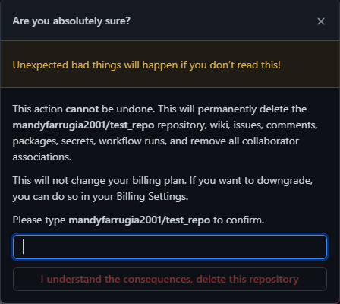
Deleting a repository
Navigate to repository settings by selecting the Settings tab, then scroll down to the Danger Zone section, as you would when changing the visibility of a repository.
Please make sure that you are 100% sure about deleting the repository, for you will not be able to recover the repository post deletion. Type the username and repository, both of which to be separated by a dash. Once you have done so, press I understand the consequences, delete this repository to proceed.

Slide 50
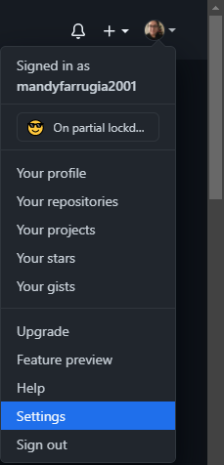
Changing appearance via Settings
Click on your avatar and a dropdown menu should show up. Navigate to Settings.
The anatomy of the link leading to account settings goes as follows:
https://github.com/settings

Slide 51
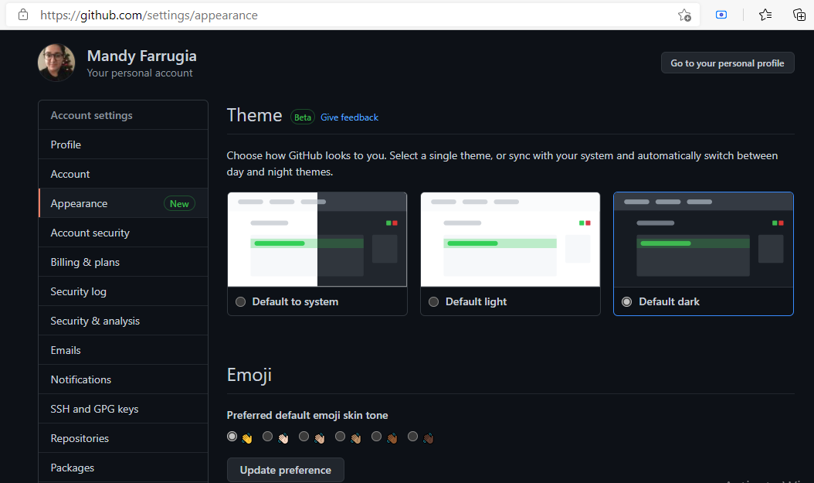
Changing appearance via Settings
You may select whichever theme you prefer. The default theme is Default light. You may alternatively switch between day and night times via a toggle button by means of Default to system.
The anatomy of the link leading to appearance settings goes as follows:
https://github.com/settings/appearance

Slide 52
Changing username via Settings
Click on your avatar and a dropdown menu should show up. Navigate to Settings.
The anatomy of the link leading to account settings goes as follows:
https://github.com/settings

Slide 53
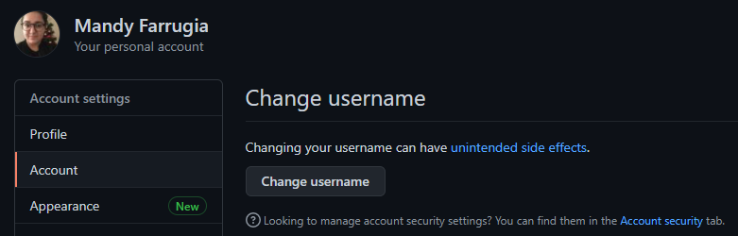
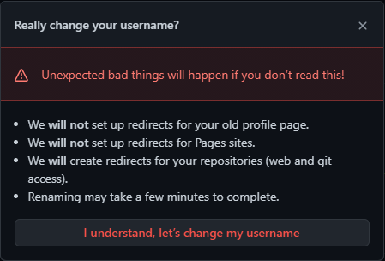
Changing username via Settings
Navigate to Account from the sidebar in Settings. Press Change username and an alert box shedding light on the risks of changing your username will show up. If you acknowledge the potential risks that come with changing your username, then press I understand, let’s change my username.
Links redirecting to your profile with the previous username will return a 404 Error. It is strongly recommended that you update links to your GitHub profile from other websites to the updated link (with the new username). Your former username will become available for other users.

Slide 54
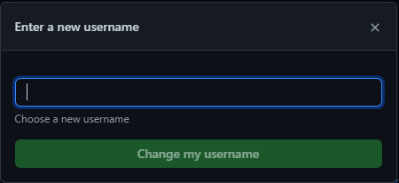
Changing username via Settings
Once you are happy with your new username, you may proceed by pressing Change your username.

Slide 55

Updating your profile
You can also personalize your account by setting a bio, as well as uploading a profile picture. This is not required, this was only to give you an idea of what more you can do with GitHub.

Slide 56
Nota bene
Previous knowledge of GitHub is not required as I will be starting from the barest minimum possible.
Sessions will be recorded and will be available via Client Side Scripting (2021) channel in Microsoft Teams.
The use and knowledge of GitHub, although strongly recommended as an alternative backup, is not mandatory. You need not worry should you refuse to use it, the course will resume as usual as the focal point of the course is web development. This was a supplementary session.
Although I proofread my presentations, should you spot any discrepancies, feel free to point them and I will rectify them as soon as possible.
“The pessimist sees difficulty in every opportunity. The optimist sees opportunity in every difficulty.”
“Make your life a masterpiece, imagine no limitations on what you can be, have or do.”
“You learn more from failure than from success. Don’t let it stop you. Failure builds character.”
“It’s not whether you get knocked down, it’s whether you get up.”

Slide 57


Slide 58


